Slide 1
Healthcare Analytics Project
Prepared by: Saraj Singhal

Slide 2
📌 Problem Statement
Hospitals face challenges in managing patient outcomes, operational efficiency, and cost control.
Data-driven decisions are essential to improve service quality and reduce overhead.

Slide 3
🎯 Project Objective
Analyze patient records and healthcare operations to generate actionable insights.
Enhance patient care, optimize resources, and reduce costs.

Slide 4
🛠️ Methodology
1. Data Cleaning & Preparation
2. Exploratory Data Analysis (EDA)
3. Data Visualization using Python
4. Hypothesis Testing
5. Insight Extraction & Recommendation Building

Slide 5

Analysis

Slide 6
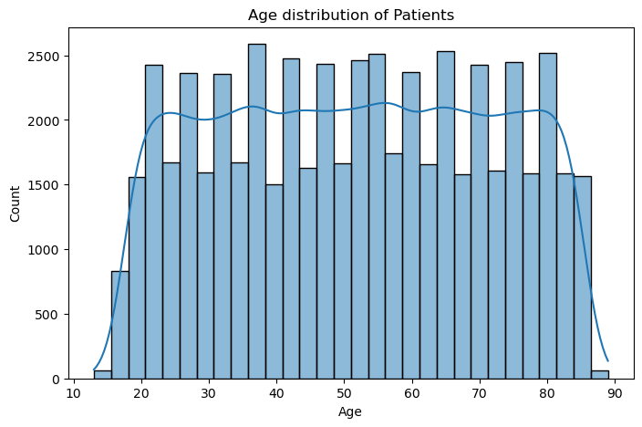
Age Distribution
Key Insight:
Most patients are aged between 30–60, indicating a need for middle-aged wellness programs.

Slide 7
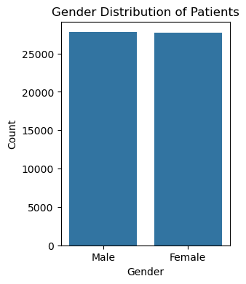
Gender Distribution
Key Insight:
Gender distribution is almost equal. Ensure gender-equitable healthcare delivery.

Slide 8
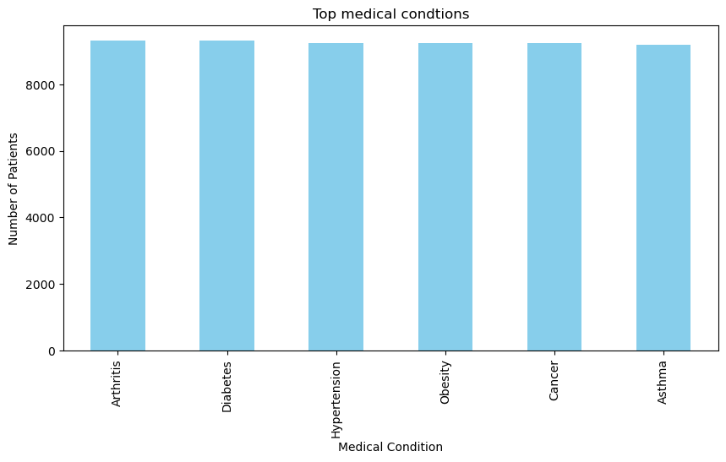
Top Medical Conditions
Key Insight:
Arthritis, Diabetes, and Hypertension are most prevalent.

Slide 9
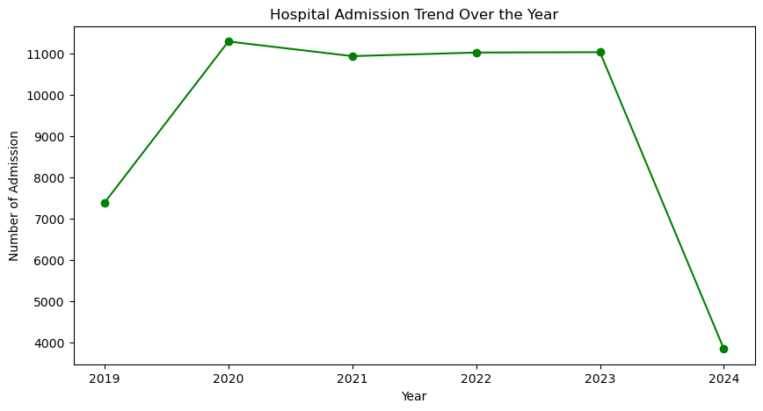
Hospital Admission Trend Over the Year
Key Insight:
Admissions are steady over the years.

Slide 10
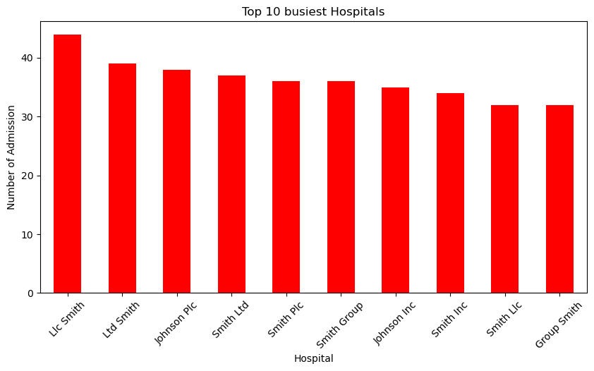
Top 10 Busiest Hospitals
Key Insight:
Certain hospitals handle high volumes and need operational support.

Slide 11
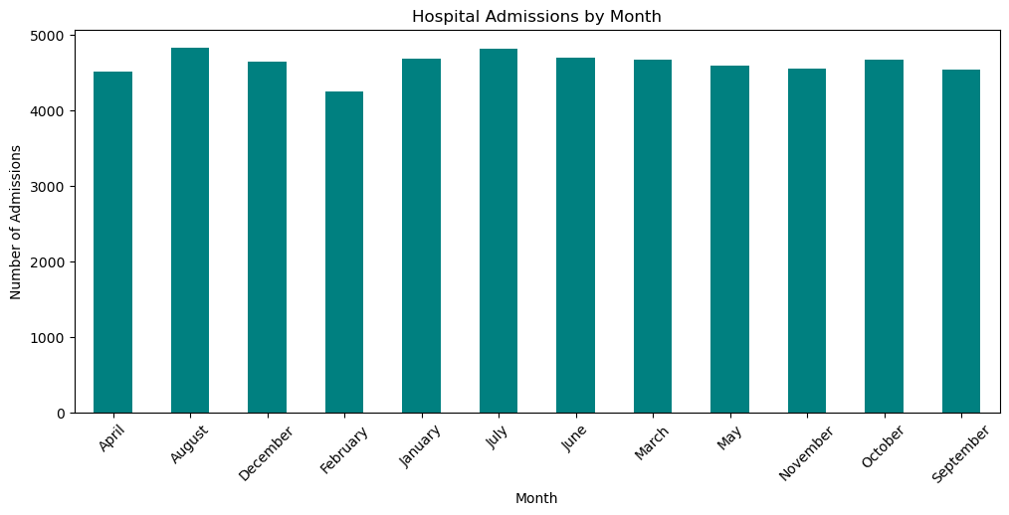
Hospital Admissions by Month
Key Insight:
Admissions peak in Aug–Oct.

Slide 12
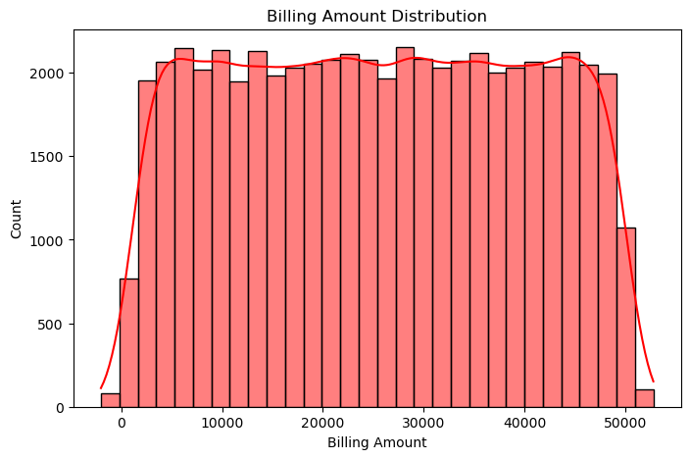
Billing Amount Distribution
Key Insight:
Most bills range from $20,000 to $30,000.

Slide 13
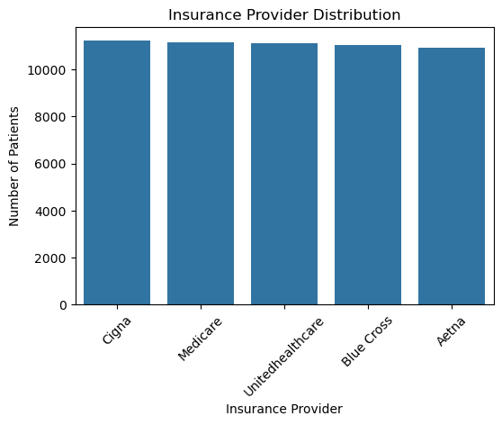
Insurance Provider Distribution
Key Insight:
Majority of patients use providers like Cigna and Medicare.

Slide 14
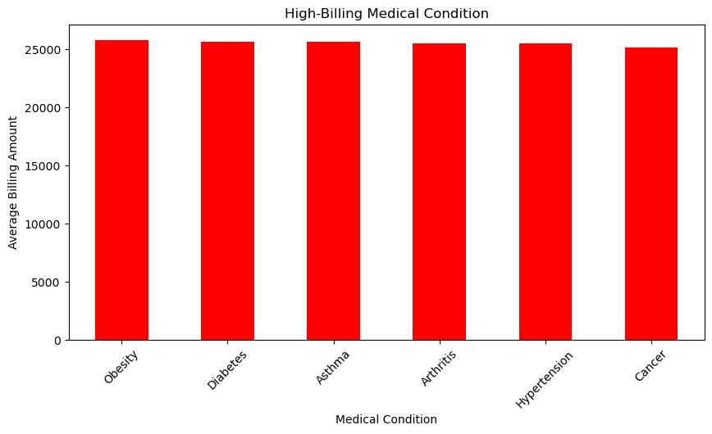
High-Billing Medical Condition
Key Insight:
Obesity and Diabetes have the slightly highest average billing.

Slide 15
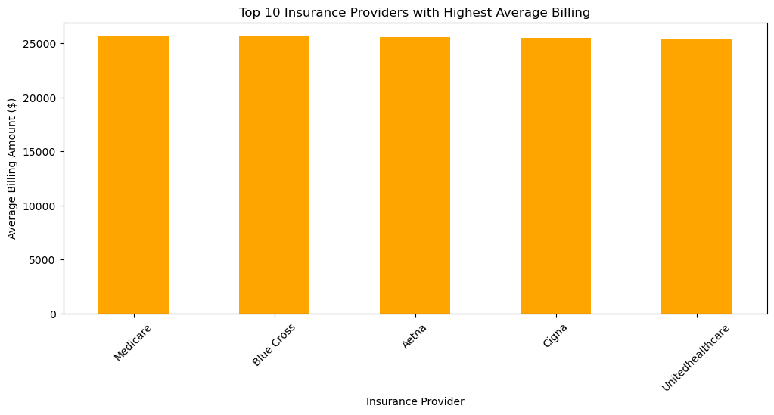
Top Insurance Providers with Highest Average Billing
Key Insight:
Billing trends are almost same across providers.

Slide 16
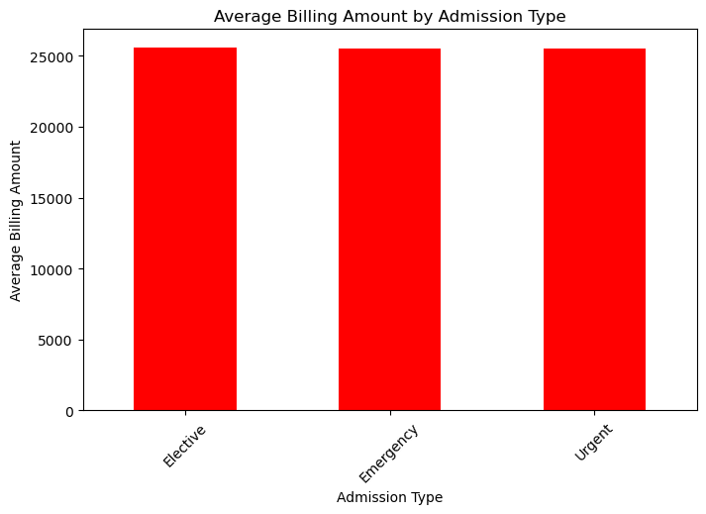
Average Billing Amount by Admission Type
Key Insight:
Elective admissions are slightly more expensive on average.

Slide 17
Insurance Provider Distribution
Key Insight: Majority of patients use providers like Cigna and Medicare.

Slide 18
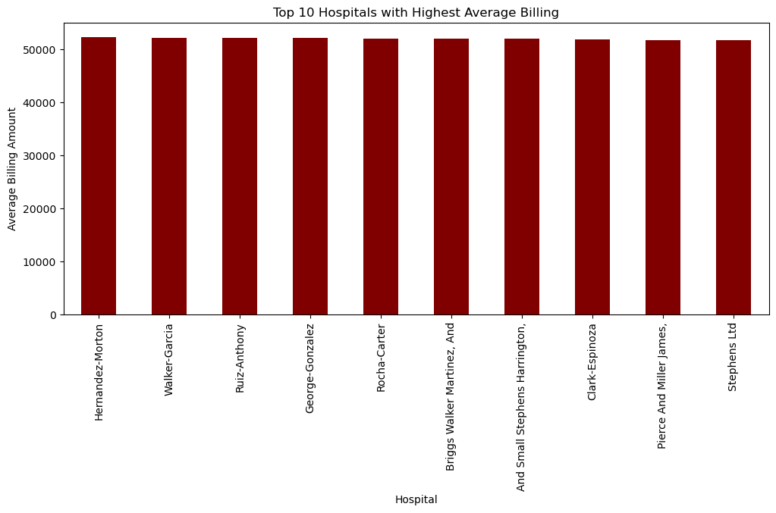
Top hospitals with Highest Average Billing
Key Insight: Billing varies significantly by hospital.

Slide 19
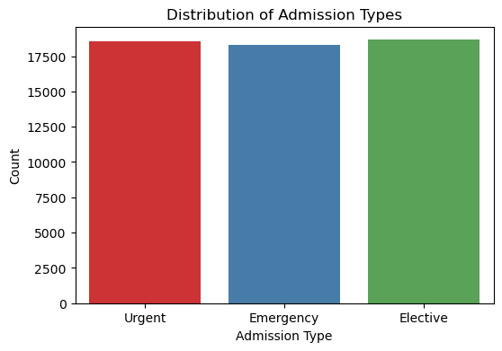
Distribution of Admission Types
Key Insight: Most admissions are urgent or emergency.

Slide 20
Hypothesis Testing Summary
Cigna vs Aetna Billing → No significant difference (p = 0.8857)
Urgent vs Elective Billing → No significant difference (p = 0.5652)
Male vs Female Stay Duration → No significant difference (p = 0.3167)

Slide 21
💡 Strategic Recommendations
✔ Focus on chronic disease prevention and management
✔ Plan for seasonal surges (Aug–Oct)
✔ Optimize elective admissions through outpatient care
✔ Standardize hospital billing practices
✔ Streamline insurance claim handling
✔ Invest in hospitals with the highest loads
✔ Use Power BI dashboards for real-time analytics

Slide 22
📌 Conclusion
This project provided valuable insights into healthcare data.
It helps in making data-informed decisions to improve patient care, reduce costs, and streamline operations.

